Slide 1
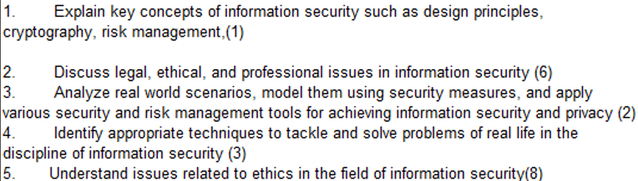
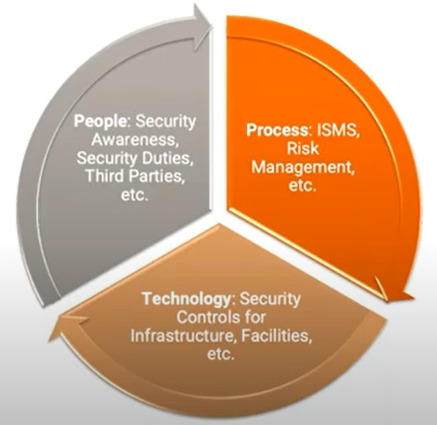
CS 3002 Information Security
Fall 2024
Week # 10 – Lecture #27, 28 and 29
22 , 23 and 24th October 2024
Dr. Aqsa Aslam

Slide 2
Backdoor
Also known as a trapdoor
Secret entry point into a program allowing the attacker to gain access and bypass the security access procedures
Maintenance hook is a backdoor used by Programmers to debug and test programs
Difficult to implement operating system controls for backdoors in applications
Notes:
The final category of payload we discuss concerns techniques used by malware to
hide its presence on the infected system, and to provide covert access to that system.
This type of payload also attacks the integrity of the infected system.
A backdoor, also known as a trapdoor, is a secret entry point into a program
that allows someone who is aware of the backdoor to gain access without going
through the usual security access procedures. Programmers have used backdoors
legitimately for many years to debug and test programs; such a backdoor is called
a maintenance hook . This usually is done when the programmer is developing an
application that has an authentication procedure, or a long setup, requiring the user
to enter many different values to run the application. To debug the program, the
developer may wish to gain special privileges or to avoid all the necessary setup and
authentication. The programmer may also want to ensure that there is a method of
activating the program should something be wrong with the authentication procedure
that is being built into the application. The backdoor is code that recognizes
some special sequence of input or is triggered by being run from a certain user ID or
by an unlikely sequence of events.
Backdoors become threats when unscrupulous programmers use them to
gain unauthorized access. The backdoor was the basic idea for the vulnerability
portrayed in the movie War Games . Another example is that during the development
of Multics, penetration tests were conducted by an Air Force “tiger team”
(simulating adversaries). One tactic employed was to send a bogus operating system
update to a site running Multics. The update contained a Trojan horse that could be
activated by a backdoor and that allowed the tiger team to gain access. The threat
was so well implemented that the Multics developers could not find it, even after
they were informed of its presence [ENGE80].
In more recent times, a backdoor is usually implemented as a network service
listening on some non-standard port that the attacker can connect to and issue commands
through to be run on the compromised system. The WannaCry ransomware,
that we described earlier in this chapter, included such a backdoor.
It is difficult to implement operating system controls for backdoors in
applications. Security measures must focus on the program development and
software update activities, and on programs that wish to offer a network service.

Slide 3
Rootkit
Set of hidden programs installed on a system to maintain covert access to that system
Hides by subverting the mechanisms that monitor and report on the processes, files, and registries on a computer
Gives administrator (or root) privileges to attacker
Can add or change programs and files, monitor processes, send and receive network traffic, and get backdoor access on demand
Notes:
A rootkit is a set of programs installed on a system to maintain covert access to that
system with administrator (or root) privileges, while hiding evidence of its presence
to the greatest extent possible. This provides access to all the functions and
services of the operating system. The rootkit alters the host’s standard functionality
in a malicious and stealthy way. With root access, an attacker has complete control
of the system and can add or change programs and files, monitor processes, send and
receive network traffic, and get backdoor access on demand.
A rootkit can make many changes to a system to hide its existence, making
it difficult for the user to determine that the rootkit is present and to identify what
changes have been made. In essence, a rootkit hides by subverting the mechanisms
that monitor and report on the processes, files, and registries on a computer.

Slide 4
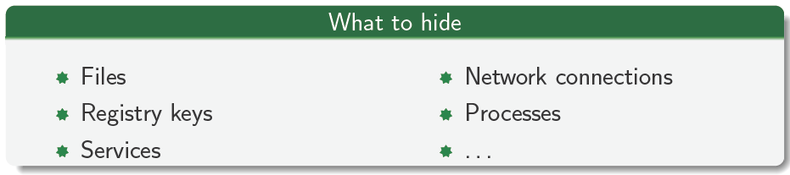
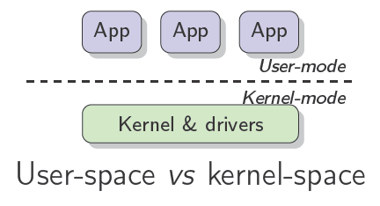
Rootkits
A rootkit is a tool used to hide, to the system administrator, the presence of a malware on the system

Slide 5
Rootkit Classification Characteristics
Persistent
Memory based
User mode
Kernel mode
Virtual machine based
External mode
Notes:
A rootkit can be classified using the following characteristics:
• Persistent: Activates each time the system boots. The rootkit must store code
in a persistent store, such as the registry or file system, and configure a method
by which the code executes without user intervention. This means it is easier
to detect, as the copy in persistent storage can potentially be scanned.
• Memory based: Has no persistent code and therefore cannot survive a reboot.
However, because it is only in memory, it can be harder to detect.
• User mode: Intercepts calls to APIs (application program interfaces) and modifies
returned results. For example, when an application performs a directory
listing, the return results don’t include entries identifying the files associated
with the rootkit.
• Kernel mode: Can intercept calls to native APIs in kernel mode. The rootkit
can also hide the presence of a malware process by removing it from the
kernel’s list of active processes.
• Virtual machine based: This type of rootkit installs a lightweight virtual
machine monitor, and then runs the operating system in a virtual machine
above it. The rootkit can then transparently intercept and modify states and
events occurring in the virtualized system.
• External mode: The malware is located outside the normal operation mode
of the targeted system, in BIOS or system management mode, where it can
directly access hardware.
This classification shows a continuing arms race between rootkit authors, who
exploit ever more stealthy mechanisms to hide their code, and those who develop
mechanisms to harden systems against such subversion, or to detect when it has
occurred. Much of this advance is associated with finding “layer-below” forms of
attack. The early rootkits worked in user mode, modifying utility programs and
libraries in order to hide their presence. The changes they made could be detected
by code in the kernel, as this operated in the layer below the user. Later-generation
rootkits used more stealthy techniques, as we discuss next.

Slide 6
A rootkit can be classified using the following characteristics:
Persistent Rootkit:
Stays active even after a reboot by storing its code in files or system settings.
Easier to detect because it leaves traces on the disk.
Memory-Based Rootkit:
Only lives in the computer's memory (RAM), so it disappears after a reboot.
Harder to detect since it doesn’t leave traces on the disk.
User-Mode Rootkit:
Works at the application level, intercepting and modifying how apps interact with the system.
Easier to spot because it affects normal programs.
Kernel-Mode Rootkit:
Runs deep in the system's core (kernel), controlling key system functions and hiding processes or files.
Very difficult to detect since it controls the operating system itself.
Virtual Machine-Based Rootkit:
Puts the operating system inside a virtual machine, allowing the rootkit to monitor and change system behavior without being seen.
Extremely hard to detect as it operates outside the normal OS.
External Mode Rootkit:
Hides in hardware components like the BIOS or firmware, bypassing the operating system entirely.
Nearly impossible to detect using regular security tools.

Slide 7
Types of User-Mode Rootkits:
API Hooking Rootkits:
The rootkit intercepts calls to system APIs used by applications to communicate with the operating system.
Example: When an application asks for a list of running processes, the rootkit hooks the API responsible for process listing and modifies the result to hide its own processes.
DLL Injection Rootkits:
Inject malicious code into running processes by loading a malicious Dynamic Link Library (DLL) into the memory of legitimate applications.
Process Hiding Rootkits:
Hide their own processes by manipulating the way task managers or system utilities list active processes, making them invisible to users.
File Redirection Rootkits:
Change file paths or prevent access to certain files by intercepting file operations to conceal their presence.

Slide 8
Types of Kernel-Mode Rootkits:
SSDT Hooking Rootkits: (Manages system calls made by user-mode applications).
Modify the System Service Descriptor Table (SSDT), which handles system calls, to redirect requests to malicious code instead of legitimate functions.
IDT Hooking Rootkits: (Manages hardware interrupts and software exceptions)
Alter the Interrupt Descriptor Table (IDT) to control how the system handles interrupts, allowing the rootkit to take over key system operations.
Driver-Based Rootkits:
Install malicious device drivers that run in kernel mode, giving the rootkit direct control over hardware and core system functions.
Kernel Object Manipulation Rootkits:
Tamper with kernel data structures, such as the Process Control Block (PCB), to hide running processes, files, or network activity from the operating system.
.

Slide 9
Malware Countermeasure Approaches
Four main elements of prevention:
Policy
Awareness
Vulnerability mitigation
Threat mitigation
Ideal solution to the threat of malware is prevention
If prevention fails, technical mechanisms can be used to support the following threat mitigation options:
Detection
Identification
Removal
Notes:
The ideal solution to the threat of malware is prevention: Do not allow malware to
get into the system in the first place, or block the ability of it to modify the system.
This goal is, in general, nearly impossible to achieve, although taking suitable countermeasures
to harden systems and users in preventing infection can significantly reduce
the number of successful malware attacks. NIST SP 800-83 suggests there are four
main elements of prevention: policy, awareness, vulnerability mitigation, and threat
mitigation. Having a suitable policy to address malware prevention provides a basis
for implementing appropriate preventative countermeasures.
One of the first countermeasures that should be employed is to ensure all
systems are as current as possible, with all patches applied, in order to reduce the
number of vulnerabilities that might be exploited on the system. The next is to set
appropriate access controls on the applications and data stored on the system, to
reduce the number of files that any user can access, and hence potentially infect or
corrupt, as a result of them executing some malware code. These measures directly
target the key propagation mechanisms used by worms, viruses, and some Trojans.
We discuss them further in Chapter 12 when we discuss hardening operating systems
and applications.
The third common propagation mechanism, which targets users in a social engineering
attack, can be countered using appropriate user awareness and training. This
aims to equip users to be more aware of these attacks, and less likely to take actions
that result in their compromise. NIST SP 800-83 provides examples of suitable awareness
issues. We will return to this topic in Chapter 17.
If prevention fails, then technical mechanisms can be used to support the
following threat mitigation options:
• Detection: Once the infection has occurred, determine that it has occurred
and locate the malware.
• Identification: Once detection has been achieved, identify the specific malware
that has infected the system.
• Removal: Once the specific malware has been identified, remove all traces of
malware virus from all infected systems so that it cannot spread further.
If detection succeeds but either identification or removal is not possible, then the
alternative is to discard any infected or malicious files and reload a clean backup
version. In the case of some particularly nasty infections, this may require a complete
wipe of all storage, and rebuild of the infected system from known clean media.
To begin, let us consider some requirements for effective malware countermeasures:
• Generality: The approach taken should be able to handle a wide variety of attacks.
• Timeliness: The approach should respond quickly so as to limit the number of
infected programs or systems and the consequent activity.
• Resiliency: The approach should be resistant to evasion techniques employed
by attackers to hide the presence of their malware.
• Minimal denial-of-service costs: The approach should result in minimal reduction
in capacity or service due to the actions of the countermeasure software,
and should not significantly disrupt normal operation.
• Transparency: The countermeasure software and devices should not require
modification to existing (legacy) OSs, application software, and hardware.
• Global and local coverage: The approach should be able to deal with attack
sources both from outside and inside the enterprise network.
Achieving all these requirements often requires the use of multiple approaches.
Detection of the presence of malware can occur in a number of locations. It
may occur on the infected system, where some host-based “anti-virus” program is
running, monitoring data imported into the system, and the execution and behavior
of programs running on the system. Or, it may take place as part of the perimeter
security mechanisms used in an organization’s firewall and intrusion detection
systems (IDS). Lastly, detection may use distributed mechanisms that gather data
from both host-based and perimeter sensors, potentially over a large number of
networks and organizations, in order to obtain the largest scale view of the movement
of malware. We now consider each of these approaches in more detail.

Slide 10
Generations of Anti-Virus Software
First generation: simple scanners
Requires a malware signature to identify the malware
Limited to the detection of known malware
Second generation: heuristic scanners
Uses heuristic rules to search for probable malware instances
Another approach is integrity checking
Third generation: activity traps
Memory-resident programs that identify malware by its actions rather than its structure in an infected program
Fourth generation: full-featured protection
Packages consisting of a variety of anti-virus techniques used in conjunction
Include scanning and activity trap components and access control capability
Notes:
The first location where anti-virus software is used is on each end system. This gives the
software the maximum access to information on not only the behavior of the malware
as it interacts with the targeted system, but also the smallest overall view of malware
activity. The use of anti-virus software on personal computers is now widespread, in
part caused by the explosive growth in malware volume and activity. This software can
be regarded as a form of host-based intrusion detection system, which we discuss more
generally in Section 8.4. Advances in virus and other malware technology, and in antivirus
technology and other countermeasures, go hand in hand. Early malware used relatively
simple and easily detected code, and hence could be identified and purged with
relatively simple anti-virus software
packages. As the malware arms race has evolved,
both the malware code and, necessarily,
anti-virus software have grown more complex
and sophisticated.
[STEP93] identifies four generations of anti-virus software:
• First generation: simple scanners
• Second generation: heuristic scanners
Third generation: activity traps
• Fourth generation: full-featured protection
A first-generation scanner requires a malware signature to identify the malware.
The signature may contain “wildcards” but matches essentially the same structure
and bit pattern in all copies of the malware. Such signature-specific scanners are
limited to the detection of known malware. Another type of first-generation scanner
maintains a record of the length of programs and looks for changes in length as a
result of virus infection.
A second-generation scanner does not rely on a specific signature. Rather, the
scanner uses heuristic rules to search for probable malware instances. One class of
such scanners looks for fragments of code that are often associated with malware.
For example, a scanner may look for the beginning of an encryption loop used in a
polymorphic virus and discover the encryption key. Once the key is discovered, the
scanner can decrypt the malware to identify it, then remove the infection and return
the program to service.
Another second-generation approach is integrity checking. A checksum
can be appended to each program. If malware alters or replaces some program
without changing the checksum, then an integrity check will catch this change.
To counter malware that is sophisticated enough to change the checksum when
it alters a program, an encrypted hash function can be used. The encryption key
is stored separately from the program so that the malware cannot generate a new
hash code and encrypt that. By using a hash function rather than a simpler checksum,
the malware is prevented from adjusting the program to produce the same
hash code as before. If a protected list of programs in trusted locations is kept, this
approach can also detect attempts to replace or install rogue code or programs in
these locations.
Third-generation programs are memory-resident programs that identify
malware by its actions rather than its structure in an infected program. Such
programs have the advantage that it is not necessary to develop signatures and
heuristics for a wide array of malware. Rather, it is necessary only to identify the
small set of actions that indicate malicious activity is being attempted and then to
intervene.
Fourth-generation products are packages consisting of a variety of anti-virus
techniques used in conjunction. These include scanning and activity trap components.
In addition, such a package includes access control capability, which limits
the ability of malware to penetrate a system and then limits the ability of a malware
to update files in order to propagate.
The arms race continues. With fourth-generation packages, a more comprehensive
defense strategy is employed, broadening the scope of defense to more
general-purpose computer security measures. These include more sophisticated
anti-virus approaches.

Slide 11
Sandbox Analysis
Running potentially malicious code in an emulated sandbox or on a virtual machine
Allows the code to execute in a controlled environment where its behavior can be closely monitored without threatening the security of a real system
Running potentially malicious software in such environments enables the detection of complex encrypted, polymorphic, or metamorphic malware
The most difficult design issue with sandbox analysis is to determine how long to run each interpretation
Notes:
One method of detecting and analyzing malware involves running
potentially malicious code in an emulated sandbox or on a virtual machine.
These allow the code to execute in a controlled environment, where its behavior
can be closely monitored without threatening the security of a real system. These
environments range from sandbox emulators that simulate memory and CPU of a
target system, up to full virtual machines, of the type we will discuss in Section 12.8,
that replicate the full functionality of target systems, but which can easily be restored
to a known state. Running potentially malicious software in such environments
enables the detection of complex encrypted, polymorphic, or metamorphic malware.
The code must transform itself into the required machine instructions, which it then
executes to perform the intended malicious actions. The resulting unpacked, transformed,
or decrypted code can then be scanned for known malware signatures, or its
behavior monitored as execution continues for possibly malicious activity [EGEL12,
KERA16]. This extended analysis can be used to develop anti-virus signatures for
new, unknown malware.
The most difficult design issue with sandbox analysis is to determine how long
to run each interpretation. Typically, malware elements are activated soon after a program
begins executing, but recent malware increasingly uses evasion approaches such
as extended sleep to evade detection in the analysis time used by sandbox systems
[KERA16]. The longer the scanner emulates a particular program, the more likely
it is to catch any hidden malware. However, the sandbox analysis has only a limited
amount of time and resources available, given the need to analyze large amounts of
potential malware.
As analysis techniques improve, an arms race has developed between malware
authors and defenders. Some malware checks to see if it is running in a sandbox or
virtualized environment, and suppresses malicious behavior if so. Other malware
includes extended sleep periods before engaging in malicious activity, in an attempt
to evade detection before the analysis terminates. Or the malware may include a logic
bomb looking for a specific date, or specific system type or network location before
engaging in malicious activity, which the sandbox environment does not match. In
response, analysts adapt their sandbox environments to attempt to evade these tests.
This race continues.

Slide 12
Host-Based Behavior-Blocking Software
Integrates with the operating system of a host computer and monitors program behavior in real time for malicious action
Blocks potentially malicious actions before they have a chance to affect the system
Blocks software in real time so it has an advantage over anti-virus detection techniques such as fingerprinting or heuristics
Limitations
Because malicious code must run on the target machine before all its behaviors can be identified, it can cause harm before it has been detected and blocked
Notes:
Unlike heuristics or fingerprint-based
scanners, dynamic malware analysis or behavior-blocking software integrates with the
operating system of a host computer and monitors program behavior in real time for
malicious actions [CONR02, EGEL12]. It is a type of host-based intrusion prevention
system, which we will discuss further in Section 9.6. This software monitors the
behavior of possibly malicious code, looking for potentially malicious actions, similar
to the sandbox systems we discussed in the previous section. However, it then has
the capability to block malicious actions before they can affect the target system.
Monitored behaviors can include the following:
• Attempts to open, view, delete, and/or modify files;
• Attempts to format disk drives and other unrecoverable disk operations;
• Modifications to the logic of executable files or macros;
• Modification of critical system settings, such as start-up settings;
• Scripting of e-mail and instant messaging clients to send executable content; and
• Initiation of network communications.
Because dynamic analysis software can block suspicious software in real time, it has
an advantage over such established anti-virus detection techniques as fingerprinting
or heuristics. There are literally trillions of different ways to obfuscate and rearrange
the instructions of a virus or worm, many of which will evade detection by a fingerprint
scanner or heuristic. But eventually, malicious code must make a well-defined
request to the operating system. Given that the behavior blocker can intercept all
such requests, it can identify and block malicious actions regardless of how obfuscated
the program logic appears to be.
Dynamic analysis alone has limitations. Because the malicious code must run on
the target machine before all its behaviors can be identified, it can cause harm before
it has been detected and blocked. For example, a new item of malware might shuffle
a number of seemingly unimportant files around the hard drive before modifying a
single file and being blocked. Even though the actual modification was blocked, the
user may be unable to locate his or her files, causing a loss to productivity or possibly
worse.

Slide 13
Perimeter Scanning Approaches
Anti-virus software typically included in e-mail and Web proxy services running on an organization’s firewall and IDS
May also be included in the traffic analysis component of an IDS
May include intrusion prevention measures, blocking the flow of any suspicious traffic
Approach is limited to scanning malware
Ingress monitors
Located at the border between the enterprise network and the Internet
One technique is to look for incoming traffic to unused local IP addresses
Egress monitors
Located at the egress point of individual LANs as well as at the border between the enterprise network and the Internet
Monitors outgoing traffic for signs of scanning or other suspicious behavior
Two types of monitoring software
Notes:
The next location where anti-virus software is used is on an organization’s firewall
and IDS. It is typically included in e-mail and Web proxy services running on these
systems. It may also be included in the traffic analysis component of an IDS. This
gives the anti-virus software access to malware in transit over a network connection
to any of the organization’s systems, providing a larger scale view of malware activity.
This software may also include intrusion prevention measures, blocking the flow
of any suspicious traffic, thus preventing it reaching and compromising some target
system, either inside or outside the organization.
However, this approach is limited to scanning the malware content, as it does
not have access to any behavior observed when it runs on an infected system. Two
types of monitoring software may be used:
• Ingress monitors: These are located at the border between the enterprise
network and the Internet. They can be part of the ingress filtering software
of a border router or external firewall or a separate passive monitor. A
honeypot can also capture incoming malware traffic. An example of a detection
technique for an ingress monitor is to look for incoming traffic to unused
local IP addresses.
• Egress monitors: These can be located at the egress point of individual LANs
on the enterprise network as well as at the border between the enterprise
network and the Internet. In the former case, the egress monitor can be part
of the egress filtering software of a LAN router or switch. As with ingress
monitors, the external firewall or a honeypot can house the monitoring software.
Indeed, the two types of monitors can be collocated. The egress monitor
is designed to catch the source of a malware attack by monitoring outgoing
traffic for signs of scanning or other suspicious behavior.
Perimeter monitoring can also assist in detecting and responding to botnet activity
by detecting abnormal traffic patterns associated with this activity. Once bots are
activated and an attack is underway, such monitoring can be used to detect the
attack. However, the primary objective is to try to detect and disable the botnet
during its construction phase, using the various scanning techniques we have just
discussed, identifying and blocking the malware that is used to propagate this type
of payload.

Slide 14
Summary
Types of malicious software (malware)
Broad classification of malware
Attack kits
Attack sources
Advanced persistent threat
Propagation-vulnerability exploit-worms
Target discovery
Worm propagation model
The Morris Worm
Brief history of worm attacks
State of worm technology
Mobile code
Mobile phone worms
Client-side vulnerabilities
Drive-by-downloads
Clickjacking
Payload-stealthing-backdoors, rootkits
Backdoor
Rootkit
Kernel mode rootkits
Virtual machine and other external rootkits
Propagation-social engineering-span E-mail, Trojans
Spam E-mail
Trojan horses
Mobile phone Trojans
Payload-system corruption
Data destruction
Real-world damage
Logic bomb
Payload-attack agent-zombie, bots
Uses of bots
Remote control facility
Payload-information theft-keyloggers, phishing, spyware
Credential theft, keyloggers, and spyware
Phishing and identity theft
Reconnaissance, espionage, and data exfiltration
Countermeasures
Malware countermeasure approaches
Host-based scanners
Signature-based anti-virus
Perimeter scanning approaches
Distributed intelligence gathering approaches
Notes:
Chapter 6 summary.

Slide 15
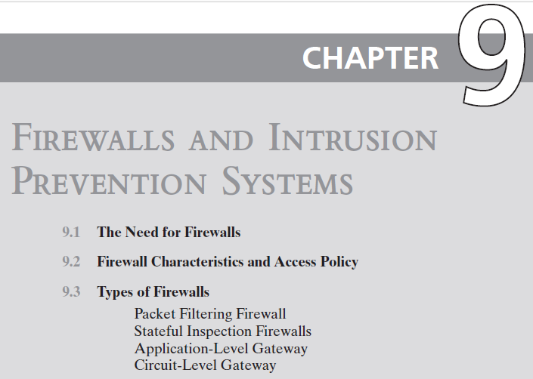

Slide 16
The Need For Firewalls
Internet connectivity is essential
However it creates a threat
Effective means of protecting LANs
Inserted between the premises network and the Internet to establish a controlled link
Can be a single computer system or a set of two or more systems working together
Used as a perimeter defense
Single choke point to impose security and auditing
Insulates the internal systems from external networks
Notes:
Internet connectivity is no longer optional for organizations. The information
and services available are essential to the organization. Moreover, individual users
within the organization want and need Internet access, and if this is not provided
via their LAN, they could use a wireless broadband capability from their PC to an
Internet service provider (ISP). However, while Internet access provides benefits to
the organization, it enables the outside world to reach and interact with local network
assets. This creates a threat to the organization. While it is possible to equip
each workstation and server on the premises network with strong security features,
such as intrusion protection, this may not be sufficient and in some cases is not cost effective.
Consider a network with hundreds or even thousands of systems, running
various operating systems, such as different versions of Windows, MacOS, and
Linux. When a security flaw is discovered, each potentially affected system must be
upgraded to fix that flaw. This requires scaleable configuration management and
aggressive patching to function effectively. While difficult, this is possible and is necessary
if only host-based security is used. A widely accepted alternative or at least
complement to host-based security services is the firewall. The firewall is inserted
between the premises network and the Internet to establish a controlled link and to
erect an outer security wall or perimeter. The aim of this perimeter is to protect the
premises network from Internet-based attacks and to provide a single choke point
where security and auditing can be imposed. The firewall may be a single computer
system or a set of two or more systems that cooperate to perform the firewall function.
The firewall, then, provides an additional layer of defense, insulating the internal
systems from external networks. This follows the classic military doctrine of
“defense in depth,” which is just as applicable to IT security.

Slide 17
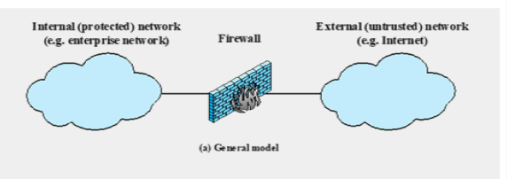
Design goals
All traffic from inside to outside, and vice versa, must pass through the firewall
Only authorized traffic as defined by the local security policy will be allowed to pass
The firewall itself is immune to penetration
Notes:
[BELL94] lists the following design goals for a firewall:
1. All traffic from inside to outside, and vice versa, must pass through the firewall.
This is achieved by physically blocking all access to the local network except via
the firewall. Various configurations are possible, as explained later in this chapter.
2. Only authorized traffic, as defined by the local security policy, will be allowed
to pass. Various types of firewalls are used, which implement various types of
security policies, as explained later in this chapter.
3. The firewall itself is immune to penetration. This implies the use of a hardened
system with a secured operating system, as we will describe in Chapter 12.

Slide 18
Firewall Access Policy
A critical component in the planning and implementation of a firewall is specifying a suitable access policy
This lists the types of traffic authorized to pass through the firewall
Includes address ranges, protocols, applications and content types
This policy should be developed from the organization’s information security risk assessment and policy
Should be developed from a broad specification of which traffic types the organization needs to support
Then refined to detail the filter elements which can then be implemented within an appropriate firewall topology
Notes:
A critical component in the planning and implementation of a firewall is
specifying a suitable access policy. This lists the types of traffic authorized to pass
through the firewall, including address ranges, protocols, applications and content
types. This policy should be developed from the organization’s information security
risk assessment and policy, that we discuss in Chapters 14 and 15. This policy
should be developed from a broad specification of which traffic types the organization
needs to support. It is then refined to detail the filter elements we discuss next,
which can then be implemented within an appropriate firewall topology.

Slide 19
Firewall Filter Characteristics
Characteristics that a firewall access policy could use to filter traffic include:
IP address and protocol values
This type of filtering is used by packet filter and stateful inspection firewalls
Typically used to limit access to specific services
Application protocol
This type of filtering is used by an application-level gateway that relays and monitors the exchange of information for specific application protocols
User identity
Typically for inside users who identify themselves using some form of secure authentication technology
Network activity
Controls access based on considerations such as the time or request, rate of requests, or other activity patterns
Notes:
NIST SP 800-41 (Guidelines on Firewalls and Firewall Policy, September 2009)
lists a range of characteristics that a firewall access policy could use to filter traffic,
including:
• IP Address and Protocol Values: Controls access based on the source or
destination addresses and port numbers, direction of flow being inbound or
outbound, and other network and transport layer characteristics. This type of
filtering is used by packet filter and stateful inspection firewalls. It is typically
used to limit access to specific services.
• Application Protocol: Controls access on the basis of authorized application
protocol data. This type of filtering is used by an application-level gateway
that relays and monitors the exchange of information for specific application
protocols, for example, checking Simple Mail Transfer Protocol (SMTP) e-mail for spam, or HTPP Web requests to
authorized sites only.
• User Identity: Controls access based on the users identity, typically for inside
users who identify themselves using some form of secure authentication technology,
such as IPSec (Chapter 22).
• Network Activity: Controls access based on considerations such as the time or
request, for example, only in business hours; rate of requests, for example, to detect scanning
attempts; or other activity patterns.

Slide 20
Firewall Capabilities And Limits
Capabilities:
Defines a single choke point
Provides a location for monitoring security events
Convenient platform for several Internet functions that are not security related
Can serve as the platform for IPSec
Limitations:
Cannot protect against attacks bypassing firewall
May not protect fully against internal threats
Improperly secured wireless LAN can be accessed from outside the organization
Laptop, PDA, or portable storage device may be infected outside the corporate network then used internally
Notes:
Before proceeding to the details of firewall types and configurations, it is best
to summarize what one can expect from a firewall. The following capabilities are
within the scope of a firewall:
1. A firewall defines a single choke point that attempts to keep unauthorized
users out of the protected network, prohibit potentially vulnerable services
from entering or leaving the network, and provide protection from various
kinds of IP spoofing and routing attacks. The use of a single choke point
simplifies security management because security capabilities are consolidated
on a single system or set of systems.
2. A firewall provides a location for monitoring security-related events. Audits
and alarms can be implemented on the firewall system.
3. A firewall is a convenient platform for several Internet functions that are not
security related. These include a network address translator, which maps local
addresses to Internet addresses, and a network management function that
audits or logs Internet usage.
4. A firewall can serve as the platform for IPSec. Using the tunnel mode capability
described in Chapter 22 , the firewall can be used to implement virtual
private networks.
Firewalls have their limitations, including the following:
1. The firewall cannot protect against attacks that bypass the firewall. Internal
systems may have dial-out or mobile broadband capability to connect to
an ISP. An internal LAN may support a modem pool that provides dial-in
capability for traveling employees and telecommuters.
2. The firewall may not protect fully against internal threats, such as a disgruntled
employee or an employee who unwittingly cooperates with an external
attacker.
3. An improperly secured wireless LAN may be accessed from outside the
organization. An internal firewall that separates portions of an enterprise
network cannot guard against wireless communications between local systems
on different sides of the internal firewall.
4. A laptop, PDA, or portable storage device may be used and infected outside
the corporate network and then attached and used internally.

Slide 21
Types of firewall

Slide 22
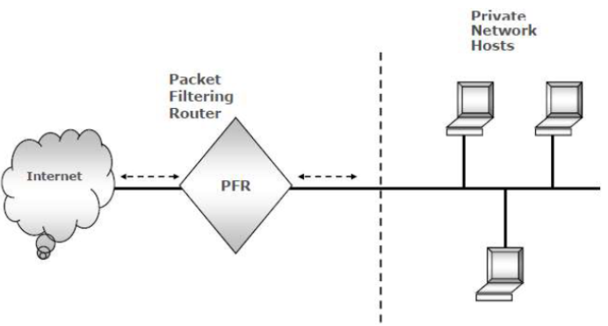
Packet Filtering Firewall
Applies rules to each incoming and outgoing IP packet
Typically a list of rules based on matches in the IP or TCP header
Forwards or discards the packet based on rules match
Two default policies:
Discard - prohibit unless expressly permitted
More conservative, controlled, visible to users
Forward - permit unless expressly prohibited
Easier to manage and use but less secure
Filtering rules are based on information contained in a network packet
Source IP address
Destination IP address
Source and destination transport-level address
IP protocol field
Interface
Notes:
A packet filtering firewall applies a set of rules to each incoming and outgoing
IP packet and then forwards or discards the packet ( Figure 9.1b ). The firewall
is typically configured to filter packets going in both directions (from and to
the internal network). Filtering rules are based on information contained in a
network packet:
• Source IP address: The IP address of the system that originated the IP packet
(e.g., 192.178.1.1)
• Destination IP address: The IP address of the system the IP packet is trying to
reach (e.g., 192.168.1.2)
• Source and destination transport-level address: The transport-level (e.g., TCP
or UDP) port number, which defines applications such as SNMP or HTTP.
• IP protocol field: Defines the transport protocol
• Interface: For a firewall with three or more ports, which interface of the firewall
the packet came from or for which interface of the firewall the packet is destined.
The packet filter is typically set up as a list of rules based on matches to fields
in the IP or TCP header. If there is a match to one of the rules, that rule is invoked
to determine whether to forward or discard the packet. If there is no match to any
rule, then a default action is taken. Two default policies are possible:
• Default = discard: That which is not expressly permitted is prohibited.
• Default = forward: That which is not expressly prohibited is permitted.
The default discard policy is more conservative. Initially, everything is blocked,
and services must be added on a case-by-case basis. This policy is more visible to
users, who are more likely to see the firewall as a hindrance. However, this is the
policy likely to be preferred by businesses and government organizations. Further,
visibility to users diminishes as rules are created. The default forward policy increases
ease of use for end users but provides reduced security; the security administrator
must, in essence, react to each new security threat as it becomes known. This policy
may be used by generally more open organizations, such as universities.

Slide 23
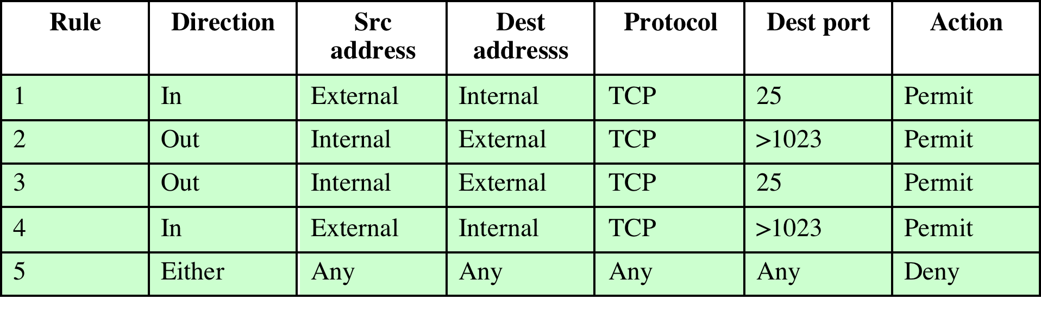
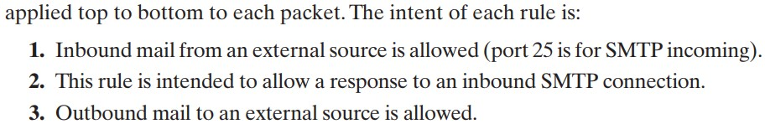
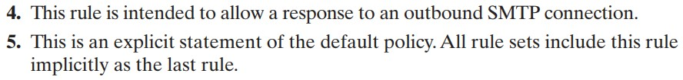
Table 9.1 Packet-Filtering Examples
Allow inbound mail from an external source on port 25 (SMTP)
Allow responses to inbound mail (SMTP connections). When a connection is established, the response typically uses a higher-numbered port.
Allow outbound mail to external servers on port 25 (SMTP).
Allow responses to outbound SMTP traffic. When an internal system sends out mail, the response comes back on a higher port.

Slide 24
Table 9.1 Packet-Filtering Examples
Rule 4 allows external traffic to any destination port above 1023.
As an example of an exploit of this rule, an external attacker can open a connection from the attacker’s port 5150 to an internal Web proxy server on port 8080. This is supposed to be forbidden and could allow an attack on the server.
To counter this attack, the firewall rule set can be configured with a source port field for each row. For rules 2 and 4, the source port is set to 25; for rules 1 and 3, the source port is set to > 1023.

Slide 25
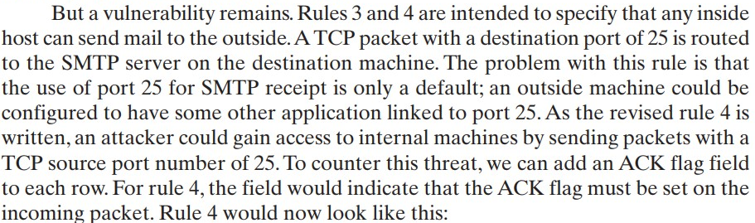
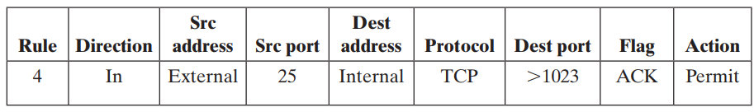
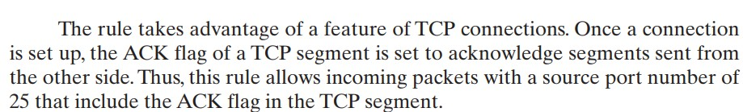

Slide 26
Packet Filter Advantages And Weaknesses
Advantages
Simplicity
Typically transparent to users and are very fast
Weaknesses
Cannot prevent attacks that employ application specific vulnerabilities or functions
Limited logging functionality
Do not support advanced user authentication
Vulnerable to attacks on TCP/IP protocol bugs
Improper configuration can lead to breaches
Notes:
One advantage of a packet filtering firewall is its simplicity. Also, packet filters
typically are transparent to users and are very fast. NIST SP 800-41 lists the following
weaknesses of packet filter firewalls:
• Because packet filter firewalls do not examine upper-layer data, they cannot
prevent attacks that employ application-specific vulnerabilities or functions.
For example, a packet filter firewall cannot block specific application
commands; if a packet filter firewall allows a given application, all functions
available within that application will be permitted.
• Because of the limited information available to the firewall, the logging
functionality present in packet filter firewalls is limited. Packet filter logs
normally contain the same information used to make access control decisions
(source address, destination address, and traffic type).
• Most packet filter firewalls do not support advanced user authentication
schemes. Once again, this limitation is mostly due to the lack of upper-layer
functionality by the firewall.
• Packet filter firewalls are generally vulnerable to attacks and exploits that take
advantage of problems within the TCP/IP specification and protocol stack,
such as network layer address spoofing . Many packet filter firewalls cannot
detect a network packet in which the OSI Layer 3 addressing information has
been altered. Spoofing attacks are generally employed by intruders to bypass
the security controls implemented in a firewall platform.
• Finally, due to the small number of variables used in access control decisions,
packet filter firewalls are susceptible to security breaches caused by improper
configurations. In other words, it is easy to accidentally configure a packet
filter firewall to allow traffic types, sources, and destinations that should be
denied based on an organization’s information security policy.
Some of the attacks that can be made on packet filtering firewalls and the
appropriate countermeasures are the following:
• IP address spoofing : The intruder transmits packets from the outside with a
source IP address field containing an address of an internal host. The attacker
hopes that the use of a spoofed address will allow penetration of systems that
employ simple source address security, in which packets from specific trusted
internal hosts are accepted. The countermeasure is to discard packets with an
inside source address if the packet arrives on an external interface. In fact, this
countermeasure is often implemented at the router external to the firewall.
• Source routing attacks: The source station specifies the route that a packet
should take as it crosses the Internet, in the hopes that this will bypass security
measures that do not analyze the source routing information. A countermeasure
is to discard all packets that use this option.
• Tiny fragment attacks: The intruder uses the IP fragmentation option to create
extremely small fragments and force the TCP header information into
a separate packet fragment. This attack is designed to circumvent filtering
rules that depend on TCP header information. Typically, a packet filter
will make a filtering decision on the first fragment of a packet. All subsequent
fragments of that packet are filtered out solely on the basis that
they are part of the packet whose first fragment was rejected. The attacker
hopes that the filtering firewall examines only the first fragment and that
the remaining fragments are passed through. A tiny fragment attack can be
defeated by enforcing a rule that the first fragment of a packet must contain
a predefined minimum amount of the transport header. If the first fragment
is rejected, the filter can remember the packet and discard all subsequent
fragments.

Slide 27
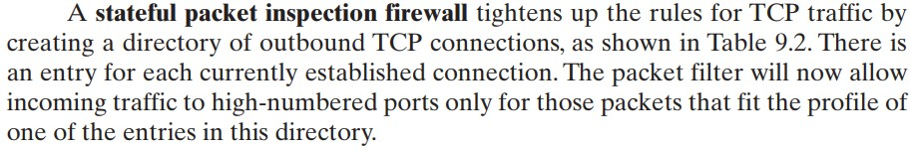
Why we need Stateful Inspection Firewall?

Slide 28
Stateful Inspection Firewall
Tightens rules for TCP traffic by creating a directory of outbound TCP connections
There is an entry for each currently established connection
Packet filter allows incoming traffic to high numbered ports only for those packets that fit the profile of one of the entries in this directory
Reviews packet information but also records information about TCP connections
Keeps track of TCP sequence numbers to prevent attacks that depend on the sequence number
Inspects data for protocols like FTP, IM and SIPS commands
Notes:
A traditional packet filter makes filtering decisions on an individual packet basis
and does not take into consideration any higher-layer context. To understand what
is meant by context and why a traditional packet filter is limited with regard to context,
a little background is needed. Most standardized applications that run on top
of TCP follow a client/server model. For example, for the Simple Mail Transfer
Protocol (SMTP), e-mail is transmitted from a client system to a server system.
The client system generates new e-mail messages, typically from user input. The
server system accepts incoming e-mail messages and places them in the appropriate
user mailboxes. SMTP operates by setting up a TCP connection between client
and server, in which the TCP server port number, which identifies the SMTP server
application, is 25. The TCP port number for the SMTP client is a number between
1024 and 65535 that is generated by the SMTP client.
In general, when an application that uses TCP creates a session with a remote
host, it creates a TCP connection in which the TCP port number for the remote
(server) application is a number less than 1024 and the TCP port number for the
local (client) application is a number between 1024 and 65535. The numbers less
than 1024 are the “well-known” port numbers and are assigned permanently to
particular applications (e.g., 25 for server SMTP). The numbers between 1024 and
65535 are generated dynamically and have temporary significance only for the
lifetime of a TCP connection.
A simple packet filtering firewall must permit inbound network traffic on all
these high-numbered ports for TCP-based traffic to occur. This creates a vulnerability
that can be exploited by unauthorized users.

Slide 29
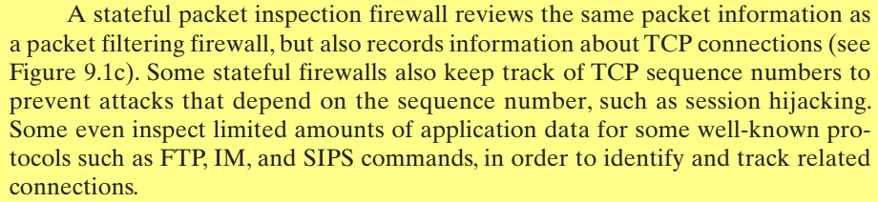
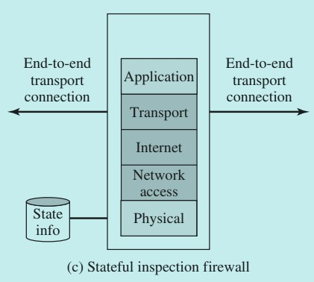
Stateful Inspection Firewall

Slide 30
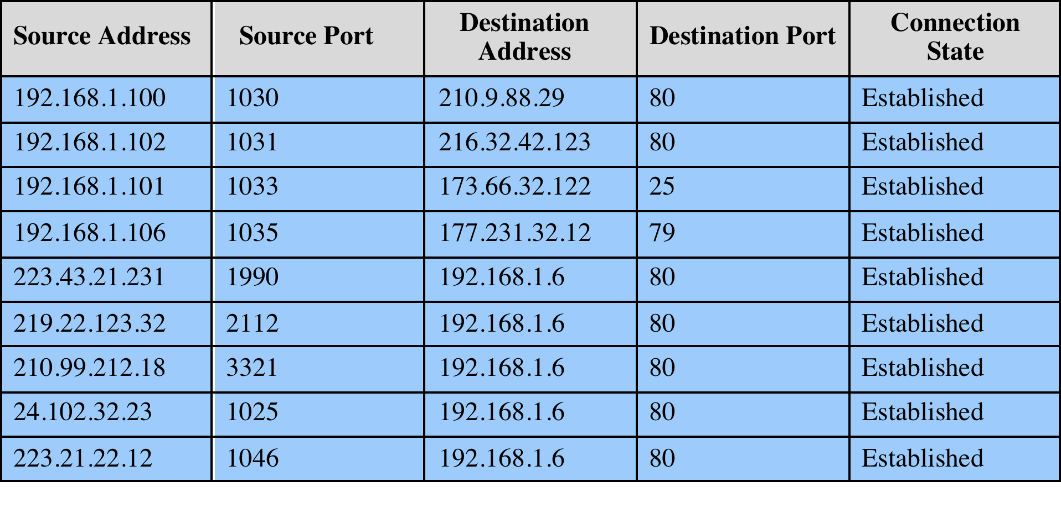
Table 9.2
Example Stateful Firewall
Connection State Table
Notes:
A stateful inspection packet firewall tightens up the rules for TCP traffic by
creating a directory of outbound TCP connections, as shown in Table 9.2 . There is
an entry for each currently established connection. The packet filter will now allow
incoming traffic to high-numbered ports only for those packets that fit the profile of
one of the entries in this directory.
A stateful packet inspection firewall reviews the same packet information
as a packet filtering firewall, but also records information about TCP connections
(Figure 9.1c). Some stateful firewalls also keep track of TCP sequence numbers
to prevent attacks that depend on the sequence number, such as session hijacking.
Some even inspect limited amounts of application data for some well-known
protocols like FTP, IM, and SIPS commands, in order to identify and track related
connections.

Slide 31
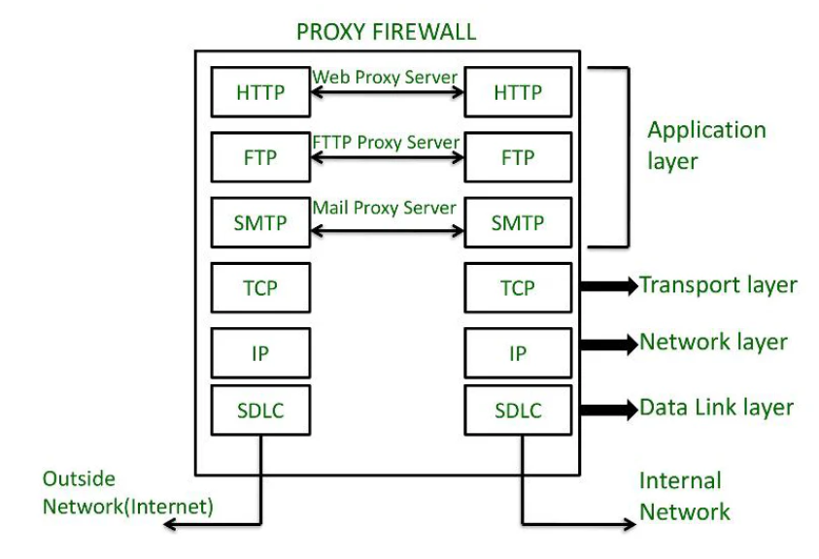
Application-Level Gateway
Also called an application proxy
Acts as a relay of application-level traffic
User contacts gateway using a TCP/IP application
User is authenticated
Gateway contacts application on remote host and relays TCP segments between server and user
Must have proxy code for each application
May restrict application features supported
Tend to be more secure than packet filters
Disadvantage is the additional processing overhead on each connection
Notes:
An application-level gateway, also called an application proxy , acts as a relay of
application-level traffic ( Figure 9.1d ). The user contacts the gateway using a TCP/
IP application, such as Telnet or FTP, and the gateway asks the user for the name
of the remote host to be accessed. When the user responds and provides a valid
user ID and authentication information, the gateway contacts the application on
the remote host and relays TCP segments containing the application data between
the two endpoints. If the gateway does not implement the proxy code for a specific
application, the service is not supported and cannot be forwarded across the firewall.
Further, the gateway can be configured to support only specific features of an
application that the network administrator considers acceptable while denying all
other features.
Application-level gateways tend to be more secure than packet filters. Rather
than trying to deal with the numerous possible combinations that are to be allowed
and forbidden at the TCP and IP level, the application-level gateway need only
scrutinize a few allowable applications. In addition, it is easy to log and audit all
incoming traffic at the application level.
A prime disadvantage of this type of gateway is the additional processing
overhead on each connection. In effect, there are two spliced connections between
the end users, with the gateway at the splice point, and the gateway must examine
and forward all traffic in both directions.

Slide 32
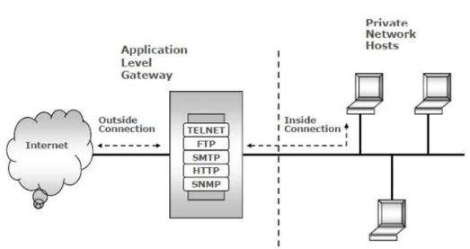
Application-Level Gateway
User interaction with the gateway:
The user contacts the gateway using a TCP/IP application (e.g., Telnet, FTP).
The gateway asks for the name of the remote host to be accessed.
The user provides a valid user ID and authentication details.
Gateway’s role:
The gateway contacts the application on the remote host.
It relays TCP segments containing the application data between the user and the remote host.
If the gateway does not have the proxy code for a specific application, the service is not supported and cannot be forwarded.
Selective support for application features:
The gateway can be configured to support only specific application features deemed acceptable by the network administrator.
All other features can be denied.
Notes:
An application-level gateway, also called an application proxy , acts as a relay of
application-level traffic ( Figure 9.1d ). The user contacts the gateway using a TCP/
IP application, such as Telnet or FTP, and the gateway asks the user for the name
of the remote host to be accessed. When the user responds and provides a valid
user ID and authentication information, the gateway contacts the application on
the remote host and relays TCP segments containing the application data between
the two endpoints. If the gateway does not implement the proxy code for a specific
application, the service is not supported and cannot be forwarded across the firewall.
Further, the gateway can be configured to support only specific features of an
application that the network administrator considers acceptable while denying all
other features.
Application-level gateways tend to be more secure than packet filters. Rather
than trying to deal with the numerous possible combinations that are to be allowed
and forbidden at the TCP and IP level, the application-level gateway need only
scrutinize a few allowable applications. In addition, it is easy to log and audit all
incoming traffic at the application level.
A prime disadvantage of this type of gateway is the additional processing
overhead on each connection. In effect, there are two spliced connections between
the end users, with the gateway at the splice point, and the gateway must examine
and forward all traffic in both directions.

Slide 33
Application-Level Gateway
Security benefits of Application-Level Gateways:
More secure than packet filters.
It only needs to scrutinize a few allowable applications rather than managing numerous TCP and IP-level combinations.
Easy to log and audit incoming traffic at the application level.
Disadvantages:
Additional processing overhead on each connection.
There are two spliced connections between the end users, with the gateway at the splice point.
The gateway must examine and forward all traffic in both directions, increasing processing requirements.
Notes:
An application-level gateway, also called an application proxy , acts as a relay of
application-level traffic ( Figure 9.1d ). The user contacts the gateway using a TCP/
IP application, such as Telnet or FTP, and the gateway asks the user for the name
of the remote host to be accessed. When the user responds and provides a valid
user ID and authentication information, the gateway contacts the application on
the remote host and relays TCP segments containing the application data between
the two endpoints. If the gateway does not implement the proxy code for a specific
application, the service is not supported and cannot be forwarded across the firewall.
Further, the gateway can be configured to support only specific features of an
application that the network administrator considers acceptable while denying all
other features.
Application-level gateways tend to be more secure than packet filters. Rather
than trying to deal with the numerous possible combinations that are to be allowed
and forbidden at the TCP and IP level, the application-level gateway need only
scrutinize a few allowable applications. In addition, it is easy to log and audit all
incoming traffic at the application level.
A prime disadvantage of this type of gateway is the additional processing
overhead on each connection. In effect, there are two spliced connections between
the end users, with the gateway at the splice point, and the gateway must examine
and forward all traffic in both directions.

Slide 34
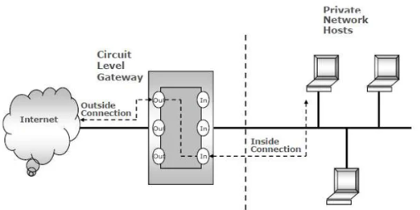
Circuit-Level Gateway
Circuit level proxy
Once both connections are set up, the gateway relays TCP segments between the two connections.
Security Function:
Typically used when inside users are trusted
May use application-level gateway inbound and circuit-level gateway outbound
Lower overheads
A circuit-level gateway can be a stand-alone system or a specialized function of an application-level gateway for certain application
It does not permit end-to-end TCP connections
Another between the gateway and a TCP user on the outside (external) host.
One between the gateway and a TCP user on the inner (internal) host.
It does not examine the content of the segments.
The security function consists of determining which connections are allowed.
The gateway does not inspect or filter the data being transferred once connections are established.
Notes:
A fourth type of firewall is the circuit-level gateway or circuit-level proxy ( Figure 9.1e ).
This can be a stand-alone system or it can be a specialized function performed by an
application-level gateway for certain applications.; rather, As with an application gateway,
a circuit-level gateway does not permit an end-to-end TCP connection
the gateway sets up two TCP connections, one between itself and a TCP user on
an inner host and one between itself and a TCP user on an outside host. Once the
two connections are established, the gateway typically relays TCP segments from
one connection to the other without examining the contents. The security function
consists of determining which connections will be allowed.
A typical use of circuit-level gateways is a situation in which the system
administrator trusts the internal users. The gateway can be configured to support
application-level or proxy service on inbound connections and circuit-level functions
for outbound connections. In this configuration, the gateway can incur the processing
overhead of examining incoming application data for forbidden functions but
does not incur that overhead on outgoing data.

Slide 35
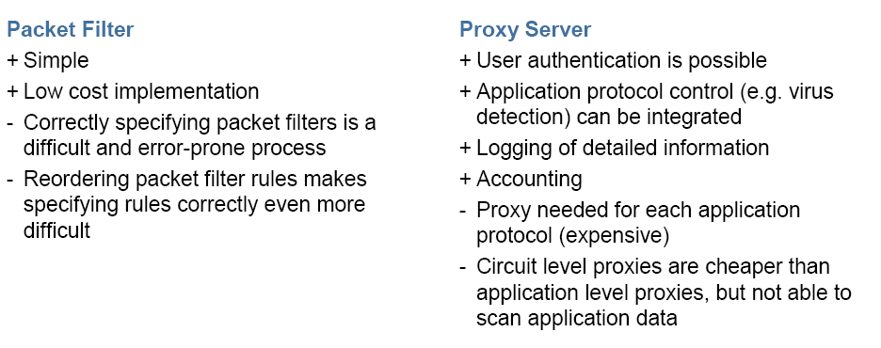
Packet Filter vs Proxy Server

Slide 36
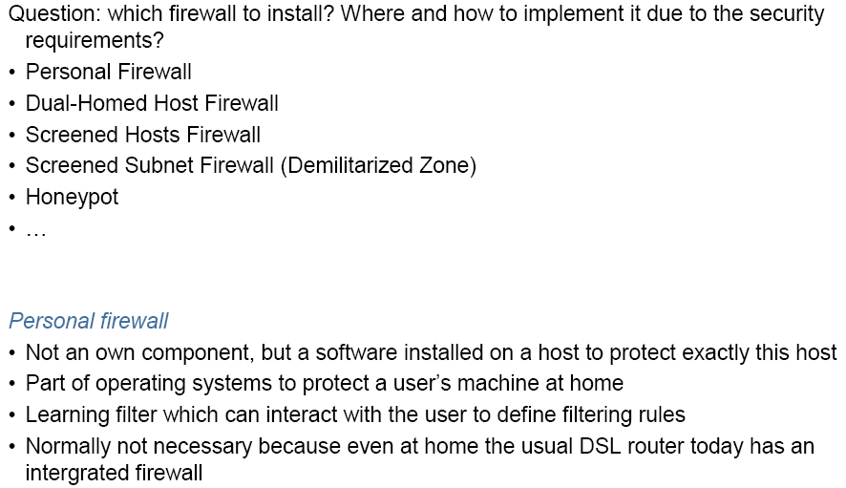
Security Architectures

Slide 37
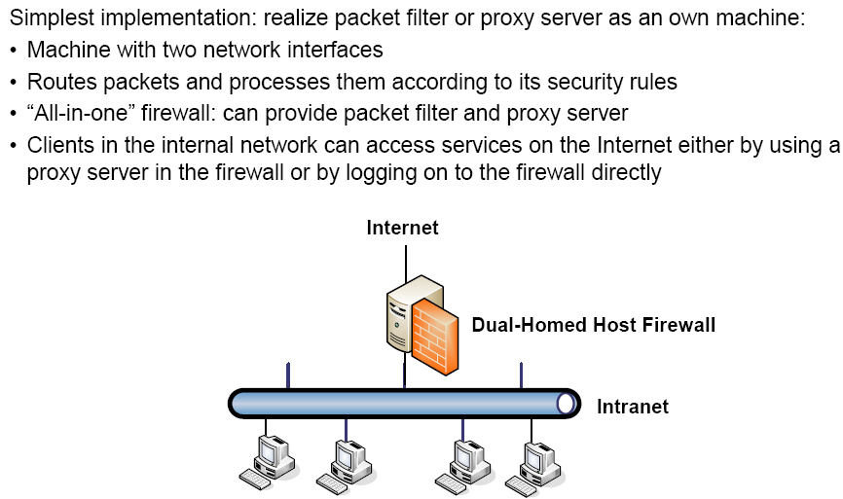

Dual-Homed Host Firewall
Notes:
A dual-homed host (or dual-homed gateway^{[1]}) is a system fitted with two network interfaces (NICs) that sits between an untrusted network (like the Internet) and trusted network (such as a corporate network) to provide secure access. Dual-homed is a general term for proxies, gateways, firewalls, or any server that provides secured applications or services directly to an untrusted network.

Slide 38
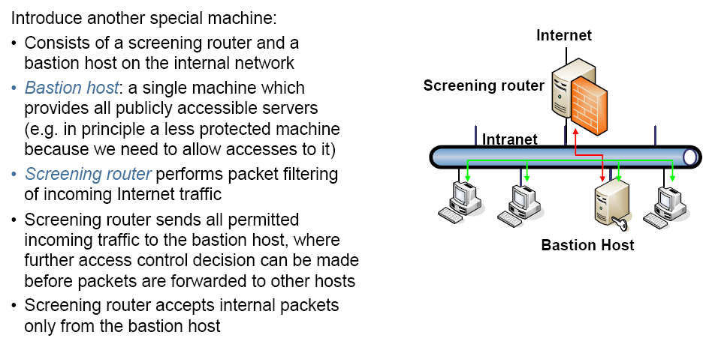
Screened Hosts Firewall

Slide 39
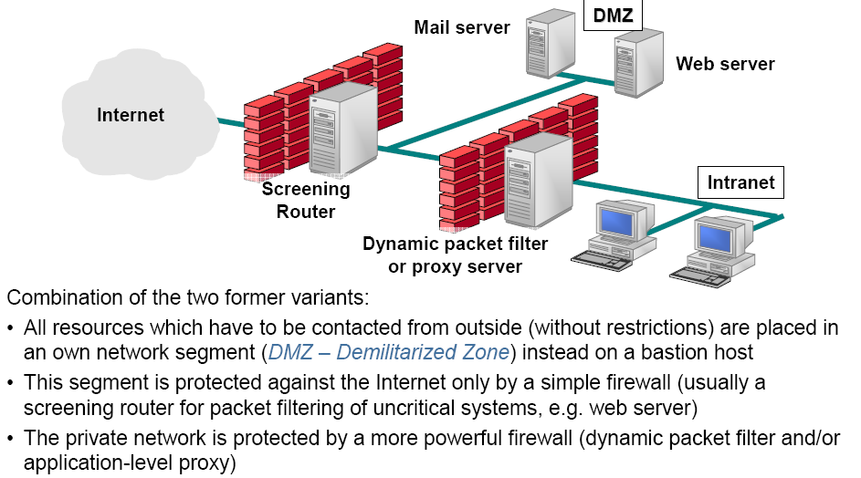
Demilitarized Zone

Slide 40
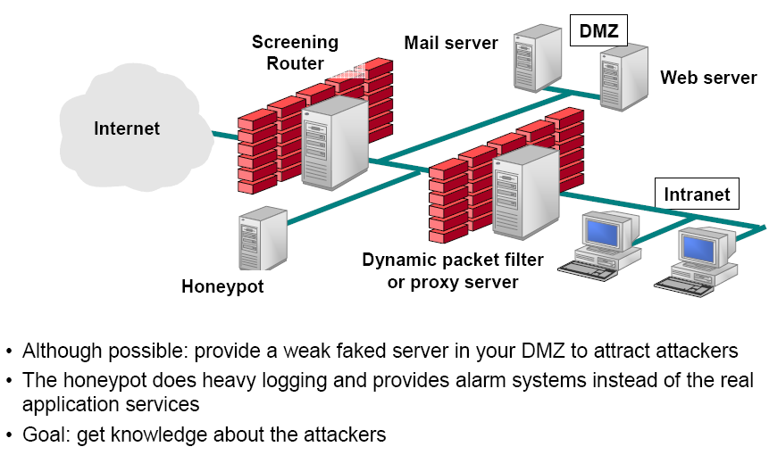
Additional: Honeypot

Slide 41
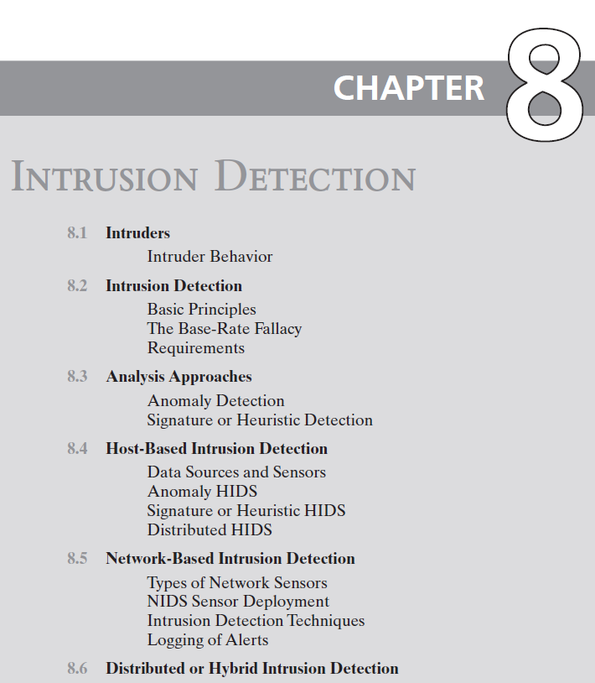
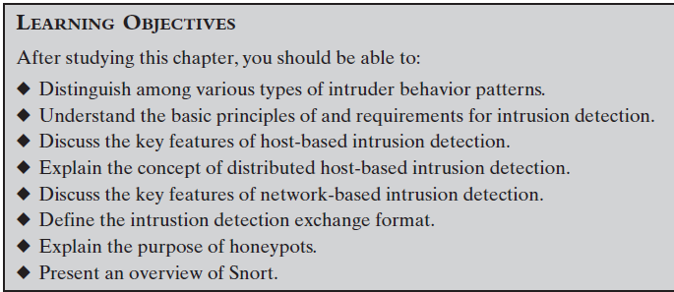

Slide 42
Examples of Intrusion
Remote root compromise of an email server
Web server defacement
Guessing/cracking passwords
Copying databases containing credit
Viewing sensitive data without authorization
Running a packet sniffer
Distributing pirated software
Using an unsecured modem to access internal
Impersonating an executive to get information
Using an unattended workstation
card numbers
network

Slide 43
Intruder Behavior
Target Acquisition & Information Gathering
Identify target systems using public information & network tools (e.g., Nmap, Shodan).
Example:-Exploring corporate website: This involves gathering public information from the company's website, such as their organizational structure, personnel details, key systems, and technologies like web servers and operating systems in use.
Initial Access
Exploit vulnerabilities or weak credentials to gain unauthorized entry (e.g., phishing, malware).
Example:- Brute forcing CMS password: Trying different combinations to guess a valid password for a user in a CMS system.
Privilege Escalation
Exploit local vulnerabilities to gain higher privileges (e.g., admin/root access).
Example:- Scanning for exploitable applications: After gaining access, scanning the system for locally installed applications with known vulnerabilities that allow privilege escalation.
Information Gathering / Exploit
Access or modify sensitive data, or move laterally to other systems.
Example:-Scanning files for desired information: Once inside a system, the attacker searches for sensitive or valuable data, such as intellectual property, personal information, financial records, or login credentials.
Maintaining Access
Install backdoors or rootkits for persistent control.
Example:- Installing a remote administration tool or rootkit: Attackers often install malware, such as a remote administration tool (RAT) or rootkit, to create a backdoor that ensures ongoing access to the compromised system without requiring re-exploitation.
Covering Tracks
Erase logs, hide malicious activity using rootkits or other stealth methods.
Example:- Using a rootkit to hide installed files: Rootkits are designed to conceal files, processes, or network activities from normal detection mechanisms, making it harder for the system’s owner to realize the system has been compromised.

Slide 44


Intrusion Detection System (IDS)
Host-based IDS (HIDS)
Monitors the characteristics of a single host for suspicious activity
Network-based IDS
(NIDS)
Monitors network traffic and analyzes network, transport, and application protocols to identify suspicious activity
Distributed or hybrid IDS
Combines information from a number of sensors, often both host and network based, in a central analyzer that is able to better identify and respond to intrusion activity
Comprises three logical components:
Sensors - collect data
Analyzers - determine if intrusion has occurred
User interface - view output or control system behavior

Slide 45
